Slide 1
Portfolio Valuation Report
Prepared by: Rishabh (Quantitative Finance Team) Date: February 2025

Slide 2
1. Introduction
Objective: Validate the portfolio valuation of a fintech lending platform as of December 31, 2020.
Approach: Analyze historical data, compute repayment rates, forecast cash flows, and determine the present value using a discount rate of 2.5% annually.

Slide 3
2. Data Overview
Dataset Period: June 2019 – December 2020
Key Data Points:
Origination amounts per vintage.
Repayments observed for each vintage.
Monthly repayment schedules.

Slide 4

3. Methodology
Step 1: Compute Historical Repayment Percentages
Formula:
Ensure repayments do not exceed 100% of the loan amount.

Slide 5
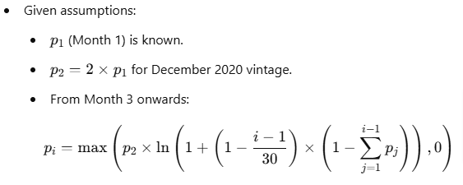
Step 2: Forecast Expected Repayment Percentages

Slide 6

Step 3: Compute Forecasted Cash Flows

Slide 7
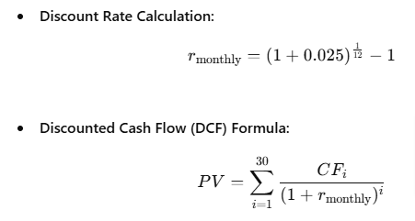
Step 4: Compute Present Value (PV) of Cash Flows

Slide 8
4. Results & Findings
Computed Portfolio Value: CHF 397,969,594.42
Client's Estimate: CHF 84,993,122.67
Absolute Difference: CHF 312,976,471.75
Relative Difference: 368.2374%
Acceptable? ❌ No (Threshold: CHF 500,000)

Slide 9
5. Issues Identified & Corrections Needed
Overestimated repayments: Forecasted repayments exceeded 100%.
Incorrect log function usage: Adjusted formula to use np.log1p().
Potential discounting errors: Validated monthly rate computation.

Slide 10
6. Recommendations & Next Steps
Adjust repayment assumptions: Introduce capping for total repayment percentages.
Refine discounting approach: Ensure correct compounding assumptions.
Validate forecast logic: Re-run calculations with corrected assumptions.
Recompute final portfolio value to ensure alignment with audit expectations.

Slide 11
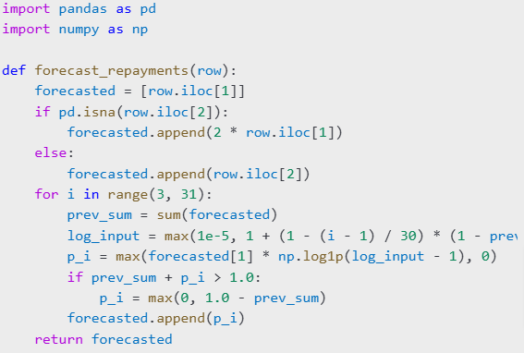
7. Appendix: Python Code Snippet

Slide 12
8. Conclusion
The computed portfolio value significantly deviates from the client's estimate.
Further refinements in repayment modeling and discounting assumptions are required.
Next steps include recalculating the portfolio value after adjustments.

